Slide 1

Large Scale Data Driven Applications
Query Language in MongoDB

Slide 2
Outline
Query – Basic Queries, Logical Operators
Basic Database Operations- Database
Basic CRUD operations

Slide 3
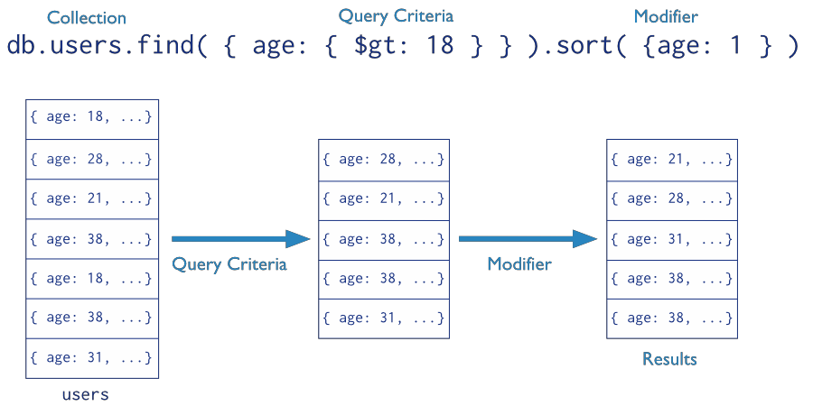
Query – Basic Queries
Query
Targets a specific collection of documents
Specifies criteria that identify the returned documents
May include a projection that specifies the fields from the matching Documents to return
May impose limits, sort orders
Means ascending

Slide 4
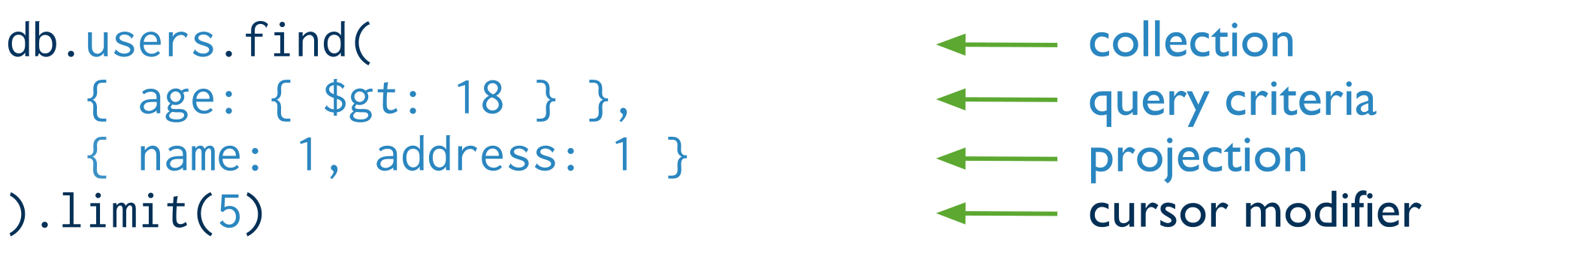
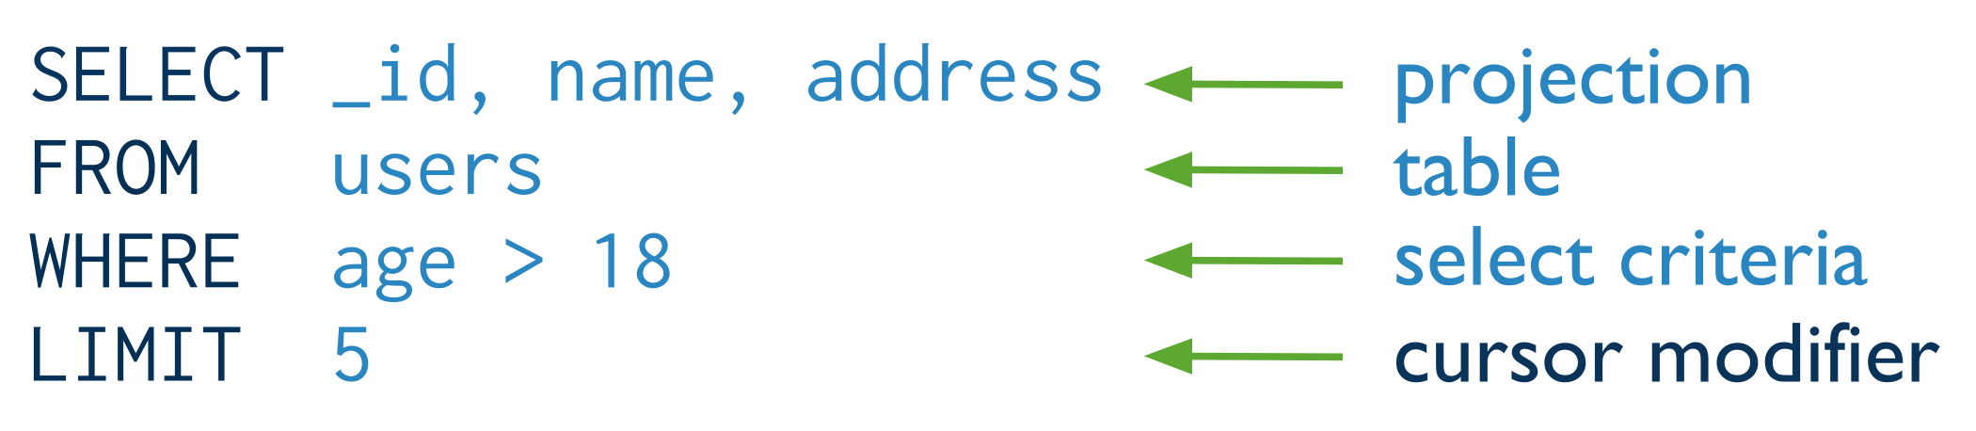
Find() + Projection
db.users.find(<query>, <projection>)
Means inclusion +
_id is always automatically included
Equivalent to in SQL:

Slide 5
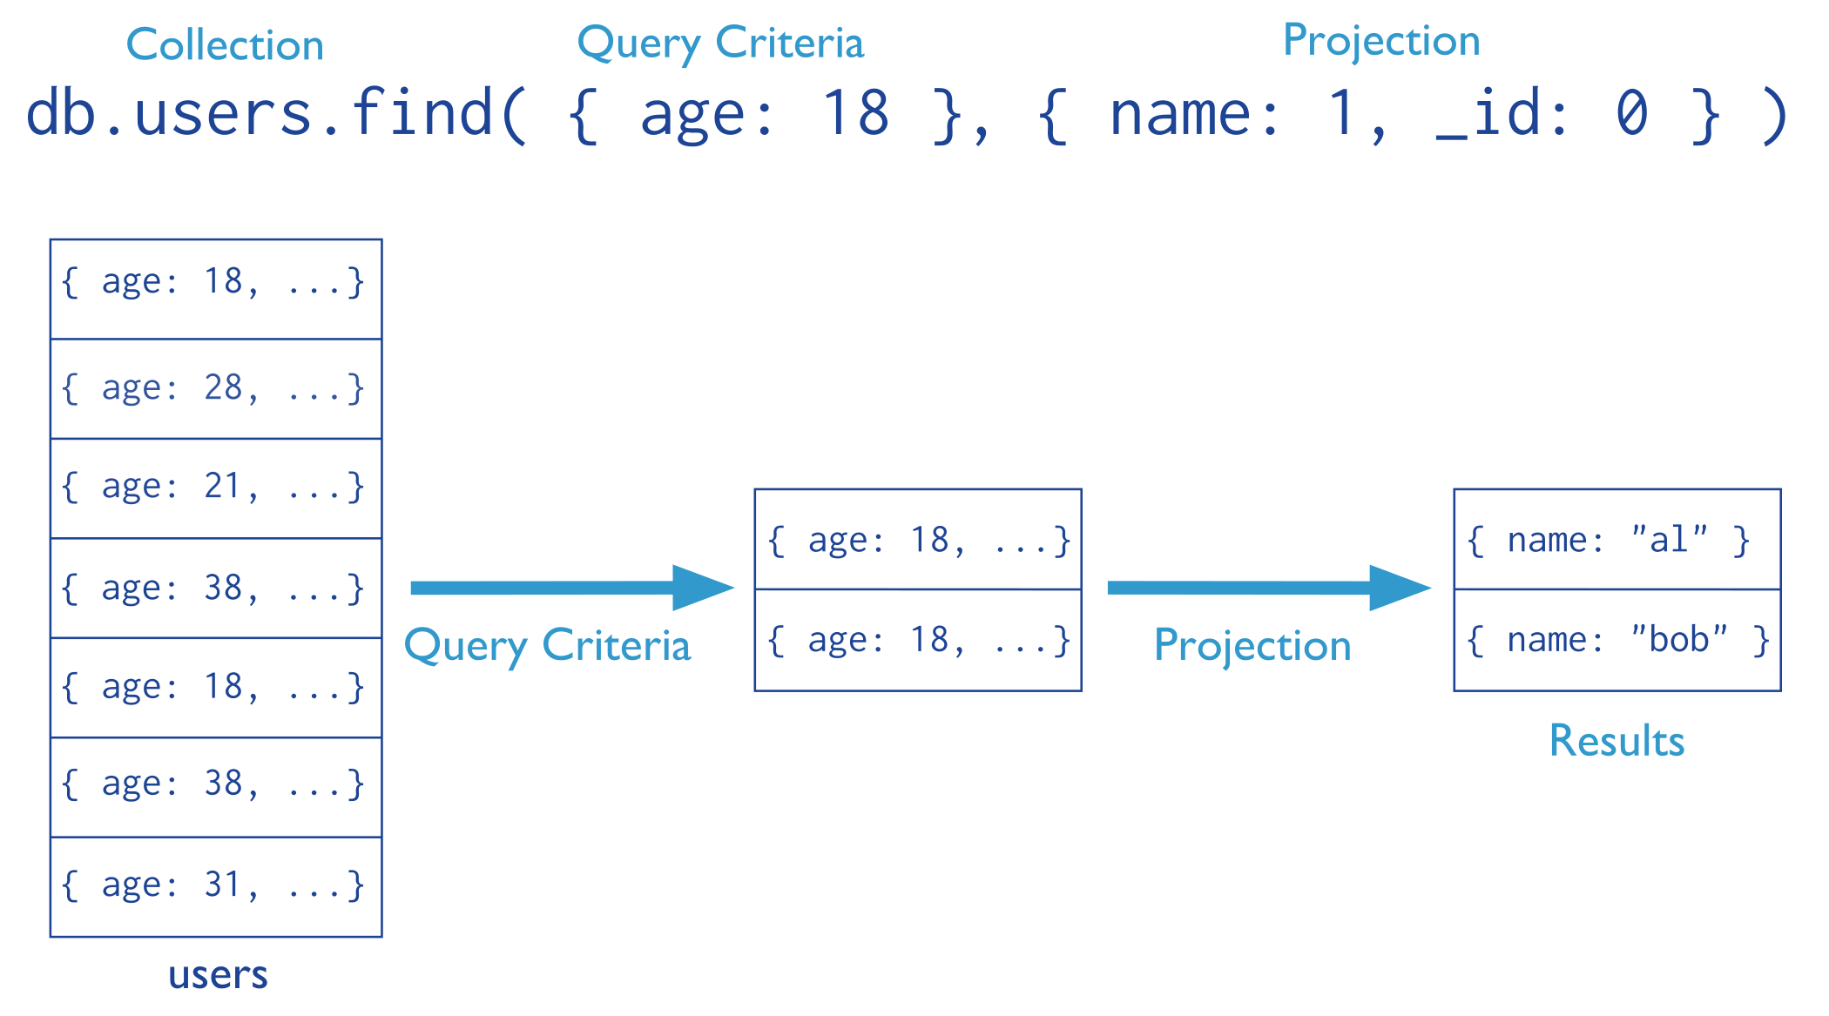
Find(): Exclude Fields
Means exclusion
Means equality
Means inclusion
Cannot mix “inclusion & exclusion” in the same operator except for _id
exclusion
not allowed
db.users.find({}, {name: 1, age: 0})
inclusion

Slide 6
Find(): Exclude Fields
db.inventory.find({type: 'food'},{item:1,qty:1})
Only the item and qty fields (and by default the _id field) return in the
matching documents
db.inventory.find({type:'food'},{item:1,qty:1,_id:0})
Only the item and qty fields return in the matching documents; _id is excluded
db.inventory.find({type:'food'}, {type:0})
The type field does not return in the matching documents

Slide 7
Find() More Examples In MongoDB
Report all documents in the “inventory” collection
db.inventory.find()
Select *
From inventory;
Equivalent to in SQL:
db.inventory.find({})
Report all documents in the “inventory” collection
Where type = ‘food’ or ‘snacks’
Equivalent to in SQL:
Select *
From inventory
Where type in
(‘food’, ‘snacks’);
db.inventory.find(
{type:{ $in:['food', 'snacks']}}
)

Slide 8
Find(): AND & OR
AND Semantics
db.students.find({ "age": { $gte: 25 }, "city": "London" })
OR Semantics
db.students.find({ $or: [ { "age": { $gte: 25 } }, { "city": "London" } ] })
AND + OR Semantics
db.students.find({
"status": "active",
$or: [ { "age": { $gte: 30 } }, { "city": "London" } ]
})

Slide 9
$AND
Examples
{$and: [1, “green”]}
{$and: []}
{$and: [[null], [false], [0]]}
{$and: [null,true]}
{$and: [0,true]}
True
True
True
False
False
Anything is true except 0 (for numbers) and null (for objects).
Arrays evaluate to True

Slide 10
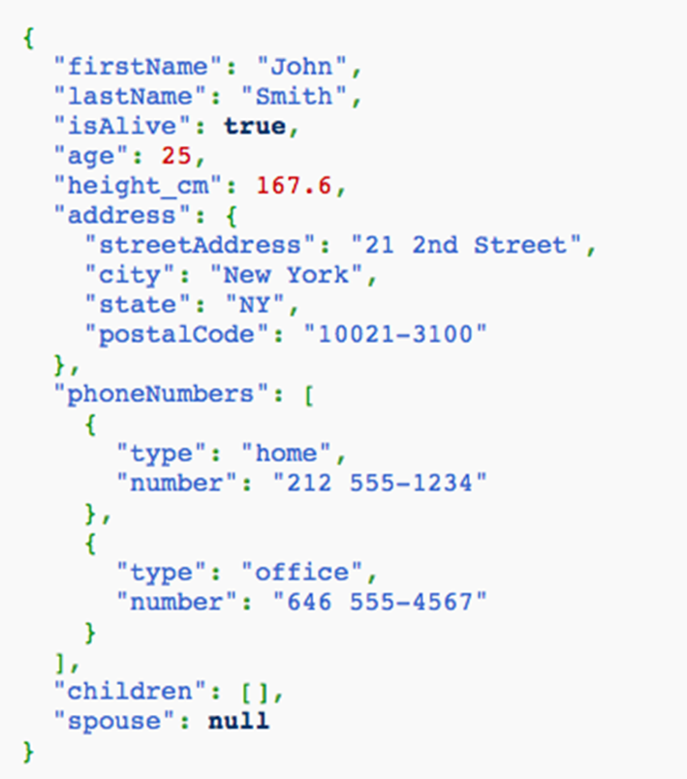
Querying Complex Types
Documents can be complex, E.g.,
(Arrays, embedded documents, any nesting of these, many levels)
Queries get complex too !!!

Slide 11
Array Manipulation (Exact Match)
inventory
{ "_id": 5, "type": "food", "item": "aaa", "ratings": [5, 8, 9] }
{ "_id": 6, "type": "food", "item": "bbb", "ratings": [5, 9] }
{ "_id": 7, "type": "food", "item": "ccc", "ratings": [9, 5, 8] }
db.inventory.find({ ratings: [5, 8, 9] })
The above query returns the following document:
{"_id": 5, "type": "food", "item": "aaa", "ratings": [5, 8, 9]}

Slide 12
Array Manipulation(Search By Element)
inventory
{ "_id": 5, "type": "food", "item": "aaa", "ratings": [5, 8, 9] }
{ "_id": 6, "type": "food", "item": "bbb", "ratings": [5, 9] }
{ "_id": 7, "type": "food", "item": "ccc", "ratings": [9, 5, 8] }
db.inventory.find({ ratings: 5})
The above query returns the following document:
{ "_id": 5, "type": "food", "item": "aaa", "ratings": [5, 8, 9] }
{ "_id": 6, "type": "food", "item": "bbb", "ratings": [5, 9] }
{ "_id": 7, "type": "food", "item": "ccc", "ratings": [9, 5, 8] }

Slide 13
Array Manipulation(Search By Position)
inventory
{ "_id": 5, "type": "food", "item": "aaa", "ratings": [5, 8, 9] }
{ "_id": 6, "type": "food", "item": "bbb", "ratings": [5, 9] }
{ "_id": 7, "type": "food", "item": "ccc", "ratings": [9, 5, 8] }
db.inventory.find({ ‘ratings.0’: 5})
The above query returns the following document:
{ "_id": 5, "type": "food", "item": "aaa", "ratings": [5, 8, 9] }
{ "_id": 6, "type": "food", "item": "bbb", "ratings": [5, 9] }

Slide 14
Array Manipulation ($elemMatch)
products
db.products.find({
"reviews.score": { $gte: 80 },
"reviews.feedback": "good"
})
{
"_id": 1,
"product": "laptop",
"reviews": [
{ "score": 80, "feedback": "good" },
{ "score": 70, "feedback": "average" }
]
},
looks for these conditions across all elements of the array
return both documents
db.products.find({
reviews: {
$elemMatch: {
score: { $gte: 80 }, feedback: "good"
}
}
})
{
"_id": 2,
"product": "tablet",
"reviews": [
{ "score": 60, "feedback": "poor" },
{ "score": 90, "feedback": "excellent" }
]
}
$elemMatch ensures that both the conditions (score >= 80 and feedback is "good") are satisfied by a single element in the reviews array.

Slide 15
Embedded Object Matching (Exact doc Matching)
{
"_id": "joe",
"name": "Joe",
"address":{
"city": "San Francisco",
"state": "CA"
},
"likes":[‘scuba’,’math’,’literature’]
}
db.persons.find({"address": {state: "CA"}})
Don’t match
db.persons.find({"address":{city:"San Francisco",state:"CA"}})
match
db.persons.find({"address":{state:"CA",city:"San Francisco"}})
Don’t match

Slide 16
Embedded Object Matching (Field Matching)
{
"_id": "joe",
"name": "Joe",
"address":{
"city": "San Francisco",
"state": "CA"
},
"likes":[‘scuba’,’math’,’literature’]
}
Find the user documents where the address’ state = ‘CA’
db.persons.find( {“address.state” : “CA”})
Using dot notation

Slide 17
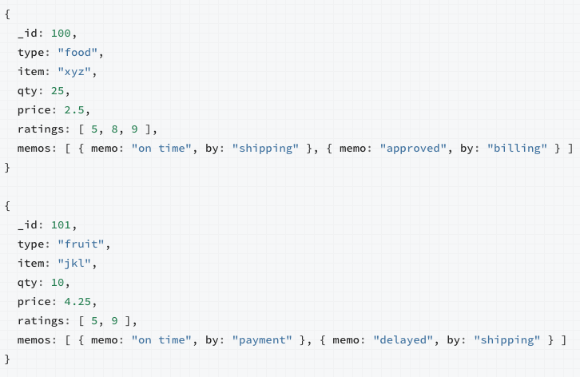
Matching Arrays of Embedded Documents
Select all documents where the memos array contains in the 1st element a document written by 'shipping’ department

Slide 18
Matching Arrays of Embedded Documents
// Returns 1st document
db.inventory.find({'memos.0.by':'shipping'})
Means the 1st element in the array

Slide 19
Matching Arrays of Embedded Documents
Select all documents where the memos array contains a document written by 'shipping’ department

Slide 20
Matching Arrays of Embedded Documents
db.inventory.find( { 'memos.by': 'shipping' } )
// Returns both documents
Means any element in the array

Slide 21
Query – Limit & skip documents of the Result
db.inventory.find().limit(10)
Use limit()method to cap the number of documents returned by the query
db.inventory.find().skip(5)
The skip()method takes an integer that specifies the number of
documents to omit from the beginning of the list of documents returned
by the find()method

Slide 22
Query – Sort Fields of the Result
db.collection.find().sort({age:-1})
Returns all documents in collection sorted by the age field in descending order
db.bios.find().sort({'name.last':1,'name.first':1})
Specifies the sort order using the fields from a sub- document name
Sorts first by the last field and then by the first field in ascending order

Slide 23
Query Operators
https://www.w3schools.com/mongodb/mongodb_query_operators.php
Comparison Operators
Logical Operators
Element Operators
Evaluation Operators
Array Operators
…

Slide 24
Query Operators: Comparison Operators
Name | Description
$eq | Matches values that are equal to a specified value.
$gt | Matches values that are greater than a specified value.
$gte | Matches values that are greater than or equal to a specified value.
$in | Matches any of the values specified in an array.
$lt | Matches values that are less than a specified value.
$lte | Matches values that are less than or equal to a specified value.
$ne | Matches all values that are not equal to a specified value.
$nin | Matches none of the values specified in an array.

Slide 25
Query Operators: Evaluation Operators
Name | Description
$expr | Allows use of aggregation expressions within the query language.
$jsonSchema | Validate documents against the given JSON Schema.
$mod | Performs a modulo operation on the value of a field and selects documents with a specified result.
$regex | Selects documents where values match a specified regular expression.
$text | Performs text search.
$where | Matches documents that satisfy a JavaScript expression.

Slide 26
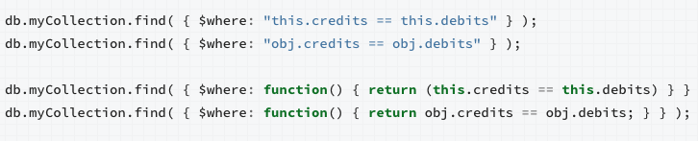
$Where Operator
Passes a JavaScript expression or function to the query system
Very flexible in expressing complex conditions
But it is relatively slow as it evaluates for each document (no indexes)
Similar to using UDF in the Where clause in relational databases
);

Slide 27
$Where Operator
Can combine MongoDB operators with $Where
db.myCollection.find( { active: true, $where: "this.credits - this.debits < 0" } );
db.myCollection.find( { active: true, $where: function() { return obj.credits - obj.debits < 0; } } );

Slide 28
Questions?

